Slide 1

Polychronicity and its Impact on Turnover Intention in the Hospitality Industry
Brian Arthaud-Day, Wenhao Zhang, Gene Barnes
Notes:
One of the major challenges facing the foodservice industry is employee retention. We wanted to look deeper into this problem to help food service organizations retain more workers.

Slide 2
The Problem
Turnover rate in Hospitality Industry is over 70% in 2016.
10 million employees in the hospitality industry leave their job.
Turnover is expensive.
Prediction of turnover intention.
Retention of employees.
Notes:
With a turnover rate of 70% in 2016 and the high cost of replacing employees, foodservice organizations have an opportunity to reduce labor expenses, increase worker productivity, and increase profits for their organizations.
In order to develop recommendations, we wanted to determine:
What are factors lead employees to leave their jobs in the foodservice industry?
What can foodservice managers do to retain those employees?

Slide 3
The Process
A Qualtrics survey was distributed to 244 full-time, non-supervisory employees working in the food services industry. Results from this survey were collected and then transposed from individual responses (numeric scale) into categorical responses for better data analysis.
Notes:
So, in order to determine the impact of the various factors on the turnover intention of hospitality workers, we distributed a survey to 854 full-time, non-supervisory food service workers across the country. We received 244 usable responses.

Slide 4
Terminology
Polychronicity: the extent to which people prefer to engage or switch among multiple tasks in the same time-block.
Work Engagement: people employ and express themselves physically, cognitively, emotionally and mentally during role performance.
Job Satisfaction: pleasurable or positive emotional state resulting from the appraisal of one’s job.
Organizational Identification: employees and the company share the same goals and values.
Job Performance: the work related activities expected of an employee and how well those activities were executed.
Turnover Intention: the likelihood of an employee leaving their organization.
Notes:
The survey asked respondents 50 questions around 6 categories and basic demographic information. The 6 categories addressed in the survey are: Polychronicity (or the extent to which people prefer to engage or switch among multiple tasks in the same time-block), Work Engagement (how people employ and express themselves physically, cognitively, emotionally and mentally during role performance), Job Satisfaction (degree of positive emotional state resulting from performing the work), Organizational Identification (similarity of values and goals between the organization and the employee), Job Performance (the degree to which the employee performs their duties and tasks to the expectations of the employer), and Turnover Intention (likelihood of that employee leaving an organization). The individual measures of these categories were averaged into means for each category, and these means were used to examine the relationship between all the elements and Turnover Intention.

Slide 5
The Data
Data cleaning.
Regression and model building.
Normality Test
Lasso
F_regression
Recursive Feature Selection
Random Forest Regressor
3. Data Visualization.

Slide 6
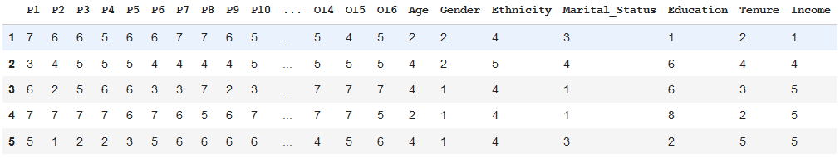
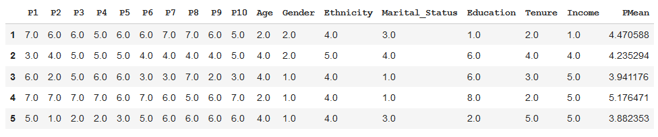
Data cleaning.

Slide 7
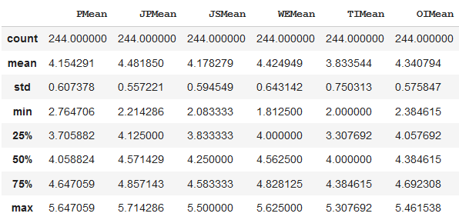
Data cleaning.

Slide 8
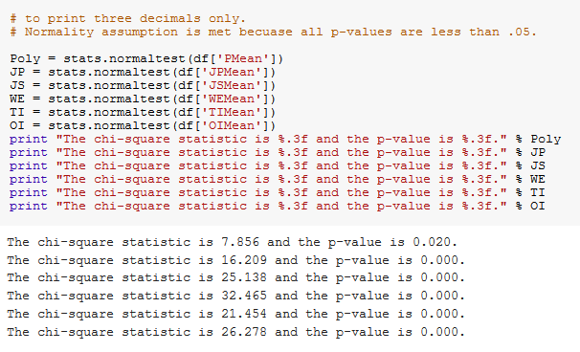
Regression and model building.
Normality Test

Slide 9
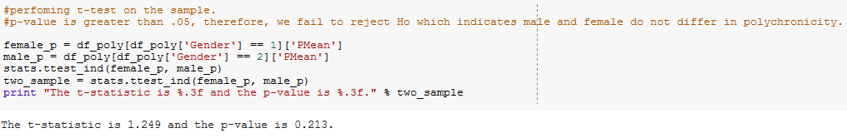
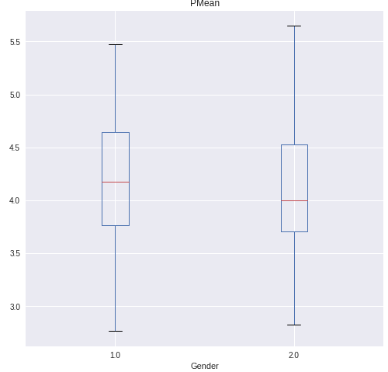
2. Regression and model building.
t-test

Slide 10
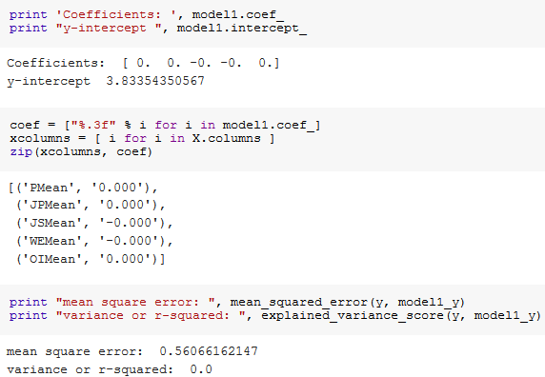
2. Regression and model building.
Lasso

Slide 11
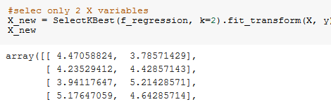
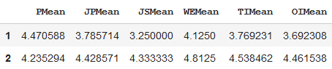
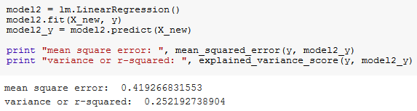
2. Regression and model building.
F_regression

Slide 12
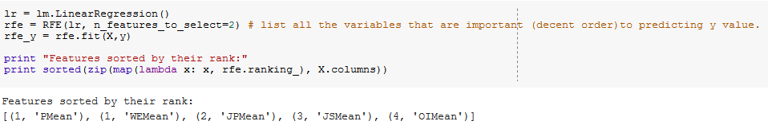
2. Regression and model building.
Recursive Feature Selection

Slide 13
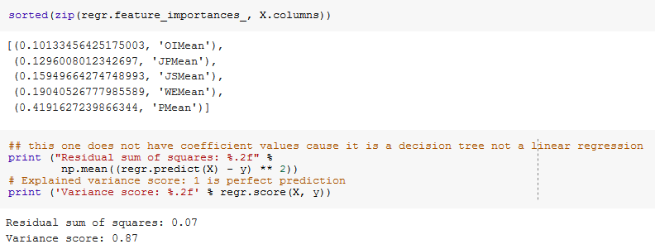
2. Regression and model building.
Random Forest Regressor

Slide 14
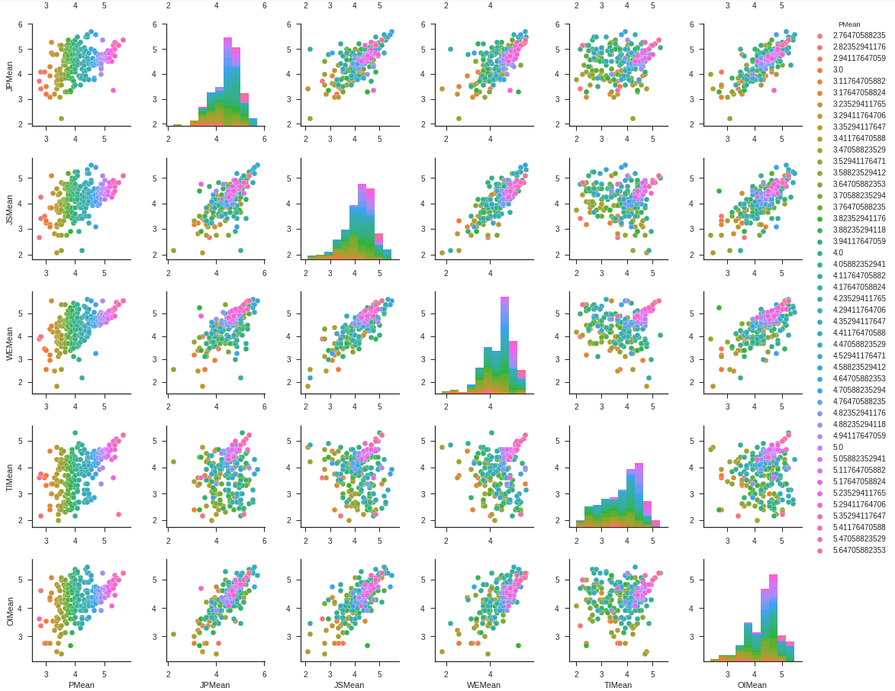
In these PairPlot graphs, each variable (WE, JS, etc.) is being compared to the Polychronicity Mean (PMean).

Slide 15
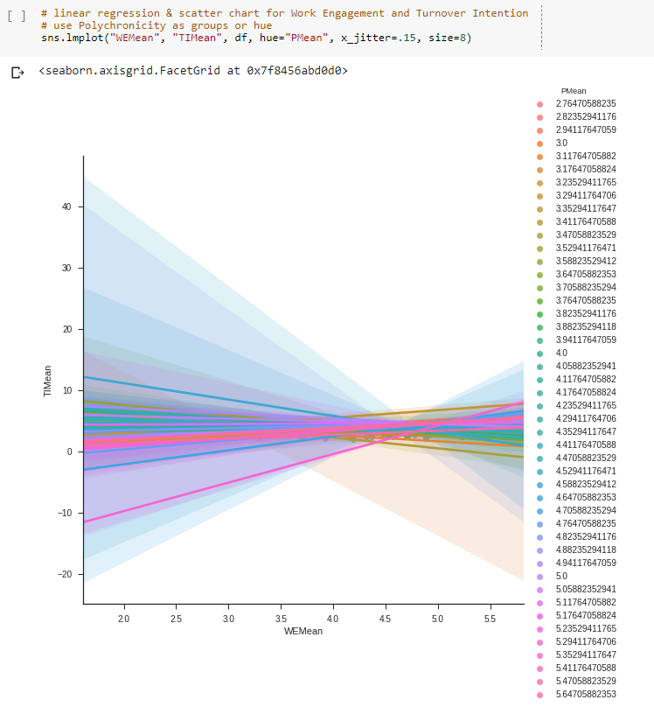
Here is the linear regression and scatter chart showing Work Engagement and Turnover Intention grouped by Polychronicity.

Slide 16
The Answer
Polychronicity is highly and positively correlated with turnover intention.
Polychronicity is highly and positively correlated with work engagement.
Work engagement is negatively correlated with turnover intention.
Notes:
The results of this study indicate that polychronicity and work engagement are the two strongest factors affecting Turnover Intention. Polychronicity, which is the preference of conducting multiple activities in the same time block, has a positive association with turnover intention. This indicates the prominence of more complex tasks tends to lead to a higher rate of turnover intention. Polychronic-oriented servers are believed to be higher performers in the organization given their time-use preference fulfills what the work environment requires. They might be more active in the job market searching for better and more challenging job opportunities.
We also found that polychronic-oriented servers are more engaged with their jobs. The work environment in restaurants are considered fast-paced and ever-changing. Interruptions are frequent and servers attentions are often divided into different dimensions. Therefore, polychronic-oriented servers tend to be more engaged with their job because what they prefer matches what the restaurant environment requires.
In contrast, higher work engagement tends to lead to a lower turnover intention by the employees. This conclusion makes sense in that the more employees are actively engaged in their work performance and environment, the more likely they are to stay with their organization.
Here are the implications from these findings:
Management should conduct tests to assess candidates’ level of polychronicity in order to better place candidates with jobs that will capitalize on their abilities
Once appropriate candidates are hired, the key is to retain polychronic-oriented servers through high level of work engagement.
Management could try to assign busier section of the restaurant or assign an extra table to highly performed polychronic-oriented servers. Also, providing them with career development opportunities such as promotion to a bartender, a shift leader, or even a manager might be considered in order to motivate and enhance level of challenge and work engagement of polychronic-oriented employees.

